Slide 1
Transcription in Eukaryotes & Translation

Slide 2
Comparison of eukaryotic and prokaryotic promoter recognition
Eukaryotes: general transcription factors (GTFs). TFI factors for RNAP I, TFII factors for RNAP II and TFIII factors for RNAP III
Prokaryotes: σ factors

Slide 3
In addition to the RNAP and GTFs, in vivo transcription also requires
Mediator complex
DNA-binding regulatory proteins
chromatin-modifying enzymes

Slide 4
RNA polymerase II core promoters are made up of combinations of 4 different sequence elements
Eukaryotic core promoter (~40 nt): the minimal set of sequence elements required for accurate transcription initiation by the Pol II machinery in vitro

Slide 5
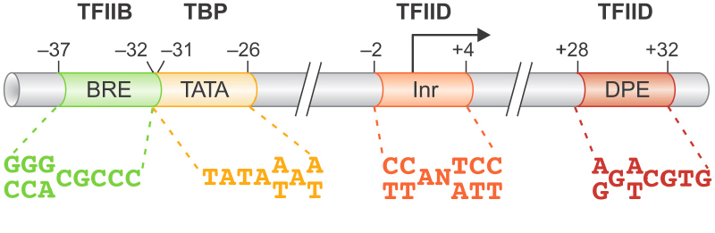
Pol II core promoter
TFIIB recognition element (BRE)
The TATA element/box
Initiator (Inr)
The downstream promoter element (DPE)

Slide 6
Regulatory sequences
The sequence elements other than the core promoter that are required to regulate the transcription efficiency
Those increasing transcription:
Promoter proximal elements
Upstream activator sequences (UASs)
Enhancers
Those repressing elements: silencers, boundary elements, insulators

Slide 7
RNA Pol II forms a pre-initiation complex with GTFs at the promoter
The involved GTFIIs (general transcription factor for Pol II)
TFIID=TBP (TATA box binding protein) + TAFs (TBP association factors)
TFIIA, B, F, E, H

Slide 8
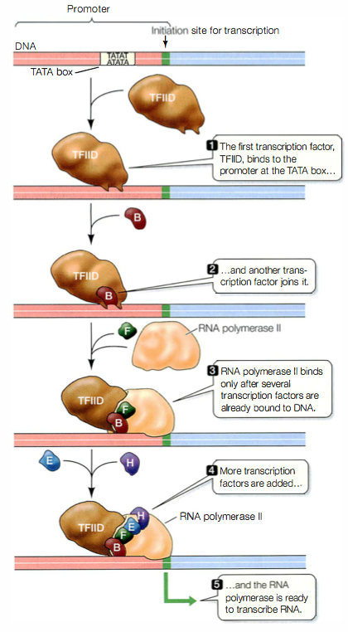
TBP in TFIID binds to the TATA box
TFIIA and TFIIB are recruited with TFIIB binding to the BRE
RNA Pol II-TFIIF complex is then recruited
TFIIE and TFIIH then bind upstream of Pol II to form the pre-initiation complex
Promoter melting using energy from ATP hydrolysis by TFIIH )
Promoter escapes after the phosphorylation of the CTD tail

Slide 9
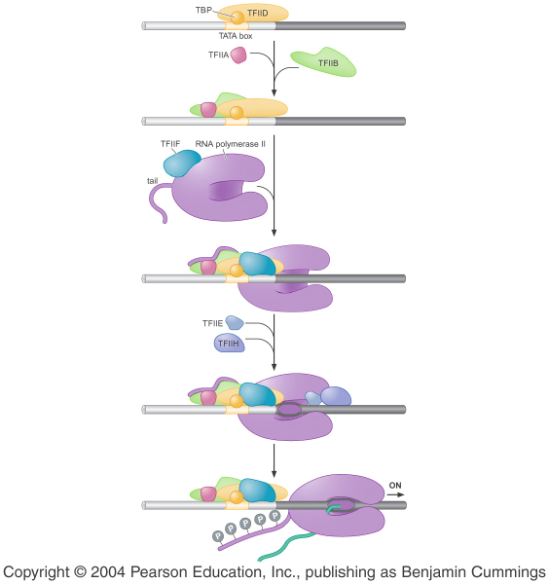
Promoter escape
Stimulated by phosphorylation of the CTD (C-terminal domain) tail of the RNAP II
CTD contains the heptapeptide repeat Tyr-Ser-Pro-Thr-Ser-Pro-Ser
Phosphorylation of the CTD “tail” is conducted by a number of specific kinases including a subunit of TFIIH

Slide 10
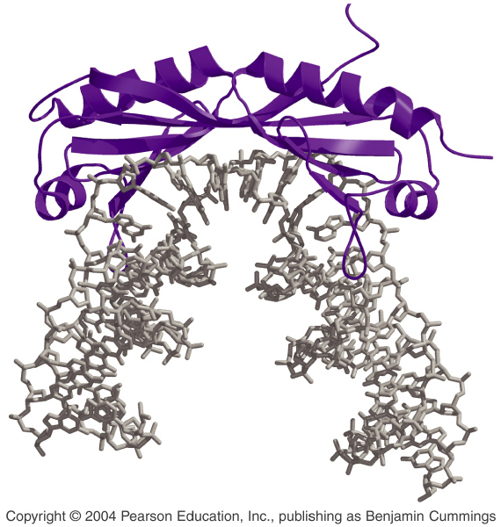
TBP binds to and distorts DNA using a β sheet inserted into the minor groove

Slide 11
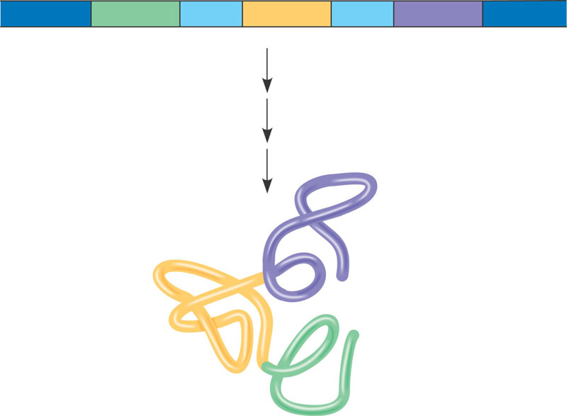
Correspondence between exons and protein domains
Gene
DNA
Exon 1
Intron
Exon 2
Intron
Exon 3
Transcription
RNA processing
Translation
Domain 3
Domain 2
Domain 1
Polypeptide

Slide 12
Translation Initiation in mRNAs
Shine Dalgarno Sequence in Prokaryotes
NNNNNNAGGAGG---8bp----AUGNNNNNNNNNN
Kozak’s Consensus Sequence in Eukaryotes
NNNNNNA/GNNAUGGNNNNNNNNNN

Slide 13
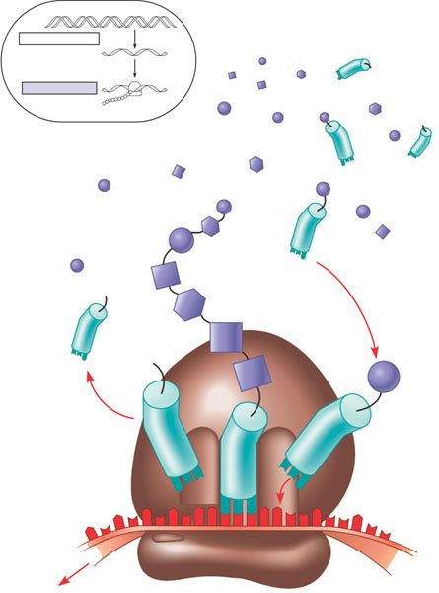
Translation: the basic concept
TRANSCRIPTION
DNA
mRNA
TRANSLATION
Ribosome
Polypeptide
Amino
acids
Polypeptide
tRNA with
amino acid
attached
Trp
Ribosome
Phe
Gly
tRNA
C
C
C
G
G
Anticodon
A
A
A
G
A
G
U
G
G
U
U
U
C
5′
Codons
3′
mRNA

Slide 14
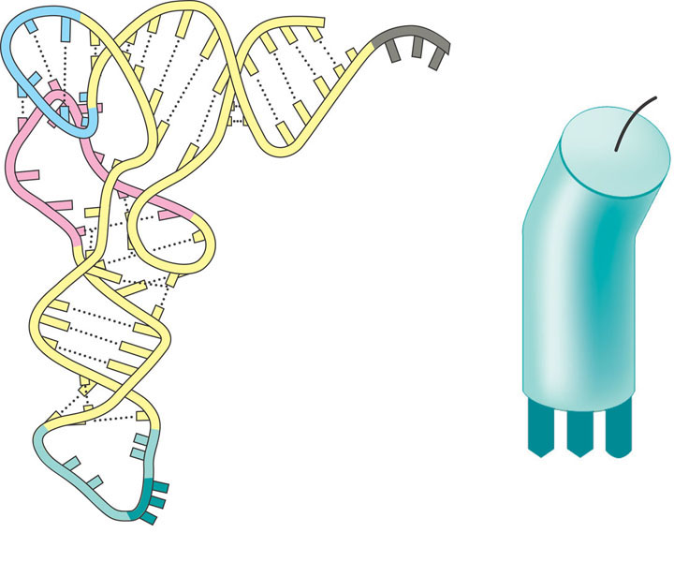
5′
Amino acid
attachment site
3′
Hydrogen
bonds
A
A
G
3′
5′
Anticodon
Anticodon
(c)
Symbol
(b) Three-dimensional structure

Slide 15
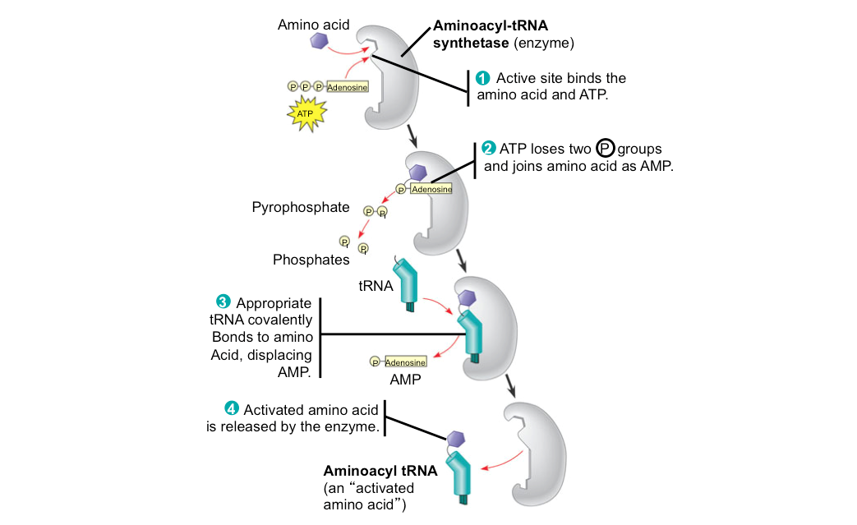
An aminoacyl-tRNA synthetase joins a specific amino acid to a tRNA

Slide 16
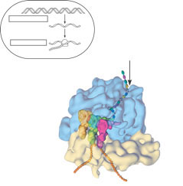
The anatomy of a functioning ribosome
TRANSCRIPTION
DNA
mRNA
Ribosome
TRANSLATION
Polypeptide
Exit tunnel
Growing
polypeptide
tRNA
molecules
Large
subunit
E
P
A
Small
subunit
5′
mRNA
3′
(a)
Computer model of functioning ribosome. This is a model of a bacterial ribosome, showing its overall
shape. The eukaryotic ribosome is roughly similar. A ribosomal subunit is an aggregate of ribosomal
RNA molecules and proteins.

Slide 17

P site (Peptidyl-tRNA
binding site)
A site (Aminoacyl-
tRNA binding site)
E site
(Exit site)
Large
subunit
E
P
A
mRNA
binding site
Small
subunit
(b)
Schematic model showing binding sites. A ribosome has an mRNA binding site and three tRNA
binding sites, known as the A, P, and E sites. This schematic ribosome will appear in later diagrams.

Slide 18
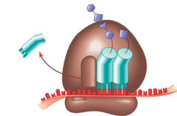
Amino end
Growing polypeptide
Next amino acid
to be added to
polypeptide chain
tRNA
mRNA
3′
5′
Codons
(c)
Schematic model with mRNA and tRNA. A tRNA fits into a binding site when its anticodon base-pairs with
an mRNA codon. The P site holds the tRNA attached to the growing polypeptide. The A site holds the tRNA
carrying the next amino acid to be added to the polypeptide chain. Discharged tRNA leaves via the E site.

Slide 19
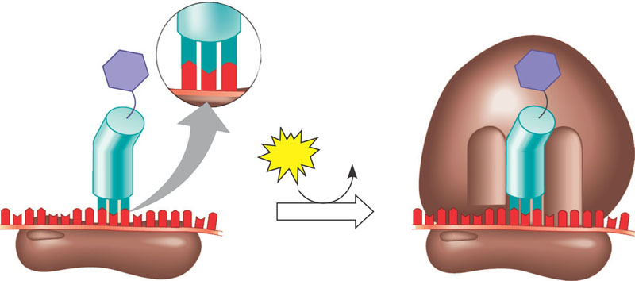
The initiation of translation
Large
ribosomal
subunit
3′
5′
P site
U
A
C
Met
5′
A
G
3′
Met
U
Initiator tRNA
GTP
GDP
E
A
mRNA
5′
3′
5′
3′
Start codon
mRNA binding site
Small
ribosomal
subunit
Translation initiation complex
1
A small ribosomal subunit binds to a molecule of
mRNA. In a prokaryotic cell, the mRNA binding site
on this subunit recognizes a specific nucleotide
sequence on the mRNA just upstream of the start
codon. An initiator tRNA, with the anticodon UAC,
base-pairs with the start codon, AUG. This tRNA
carries the amino acid methionine (Met).
2
The arrival of a large ribosomal subunit completes
the initiation complex. Proteins called initiation
factors (not shown) are required to bring all the
translation components together. GTP provides
the energy for the assembly. The initiator tRNA is
in the P site; the A site is available to the tRNA
bearing the next amino acid.

Slide 20
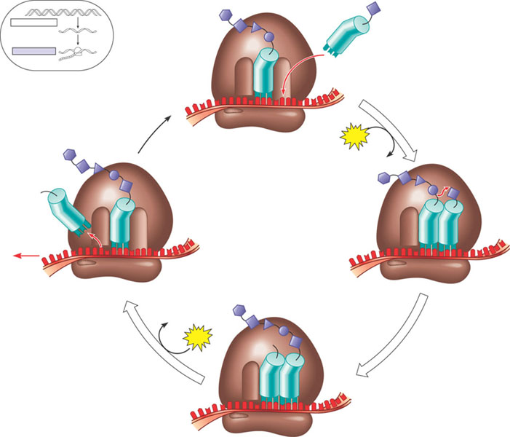
The elongation cycle of translation
1
Codon recognition. The anticodon
of an incoming aminoacyl tRNA
base-pairs with the complementary
mRNA codon in the A site. Hydrolysis
of GTP increases the accuracy and
efficiency of this step.
DNA
Amino end
of polypeptide
TRANSCRIPTION
mRNA
TRANSLATION
Ribosome
Polypeptide
E
mRNA
3′
Ribosome ready for
next aminoacyl tRNA
P
A
5′
site
site
2
GTP
2
GDP
E
E
P
A
P
A
2
Peptide bond formation. An
rRNA molecule of the large
Subunit catalyzes the formation
of a peptide bond between the
new amino acid in the A site and
the carboxyl end of the growing
polypeptide in the P site. This step
attaches the polypeptide to the
tRNA in the A site.
GDP
Translocation. The ribosome
translocates the tRNA in the A
site to the P site. The empty tRNA
in the P site is moved to the E site,
where it is released. The mRNA
moves along with its bound tRNAs,
bringing the next codon to be
translated into the A site.
3
GTP
E
P
A

Slide 21
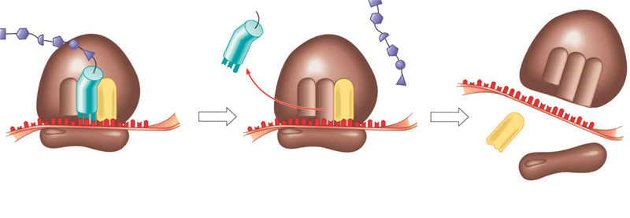
The termination of translation
Release
factor
Free
polypeptide
5′
3′
3′
3′
5′
5′
Stop codon
(UAG, UAA, or UGA)
1
When a ribosome reaches a stop
codon on mRNA, the A site of the
ribosome accepts a protein called
a release factor instead of tRNA.
2
The release factor hydrolyzes
the bond between the tRNA in
the P site and the last amino
acid of the polypeptide chain.
The polypeptide is thus freed
from the ribosome.
3
The two ribosomal subunits
and the other components of
the assembly dissociate.

Slide 22
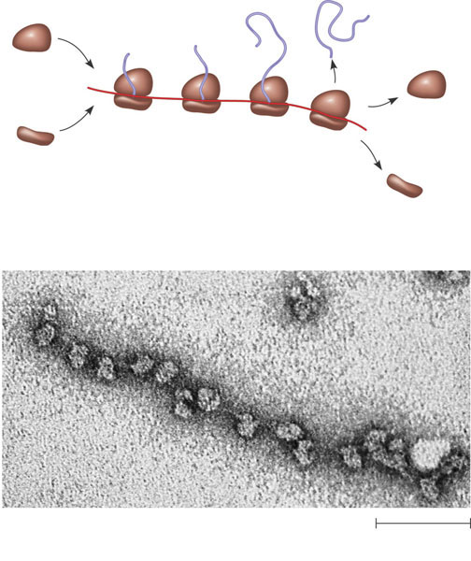
Polyribosomes
Completed
polypeptide
Growing
polypeptides
Incoming
ribosomal
subunits
Start of
mRNA
(5′ end)
Polyribosome
End of
mRNA
(3′ end)
(a)
An mRNA molecule is generally translated simultaneously
by several ribosomes in clusters called polyribosomes.
Ribosomes
mRNA
0.1 µm
(b)
This micrograph shows a large polyribosome in a prokaryotic
cell (TEM).

Slide 23
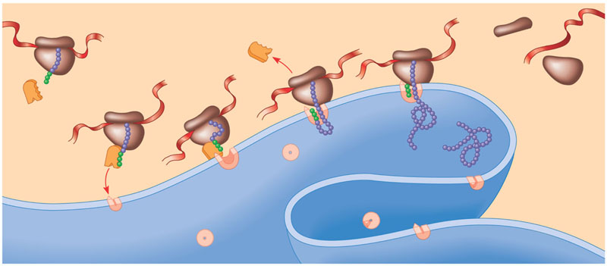
The signal mechanism for targeting proteins to the ER
Polypeptide
synthesis begins
on a free
ribosome in
the cytosol.
An SRP binds
to the signal
peptide, halting
synthesis
momentarily.
The SRP binds to a
receptor protein in the ER
membrane. This receptor
is part of a protein complex
(a translocation complex)
that has a membrane pore
and a signal-cleaving enzyme.
The SRP leaves, and
the polypeptide resumes
growing, meanwhile
translocating across the
membrane. (The signal
peptide stays attached
to the membrane.)
The signal-
cleaving
enzyme
cuts off the
signal peptide.
The rest of
the completed
polypeptide leaves
the ribosome and
folds into its final
conformation.
1
2
3
4
5
6
Ribosome
mRNA
Signal
peptide
ER
membrane
Signal-
recognition
particle
(SRP)
Signal
peptide
removed
Protein
SRP
receptor
protein
CYTOSOL
Translocation
complex

Slide 24
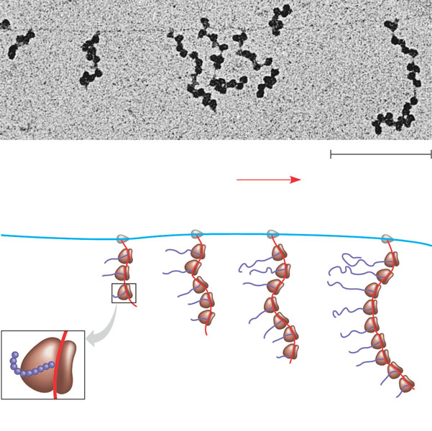
Coupled transcription and translation in bacteria
RNA polymerase
DNA
mRNA
Polyribosome
Direction of
transcription
0.25 μm
RNA
polymerase
DNA
Polyribosome
Polypeptide
(amino end)
Ribosome
mRNA (5′ end)

Slide 25
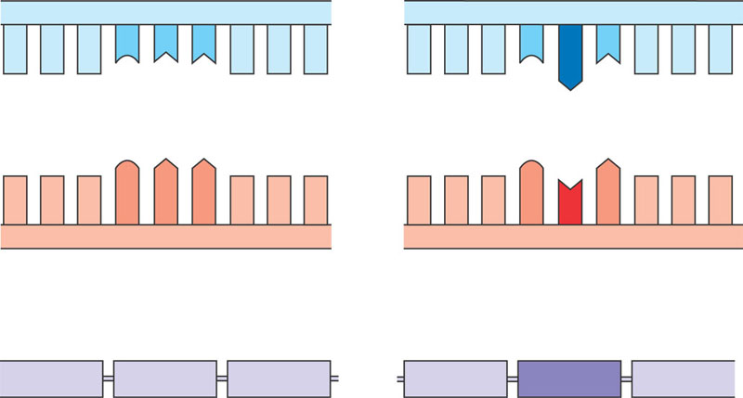
The molecular basis of sickle-cell disease: a point mutation
Wild-type hemoglobin DNA
Mutant hemoglobin DNA
In the DNA, the
mutant template
strand has an A where
the wild-type template
has a T.
3′
5′
3′
5′
C
T
T
C
A
T
mRNA
mRNA
The mutant mRNA has
a U instead of an A in
one codon.
G
A
A
G
U
A
5′
3′
5′
3′
Normal hemoglobin
Sickle-cell hemoglobin
The mutant (sickle-cell)
hemoglobin has a valine
(Val) instead of a glutamic
acid (Glu).
Glu
Val

Slide 26
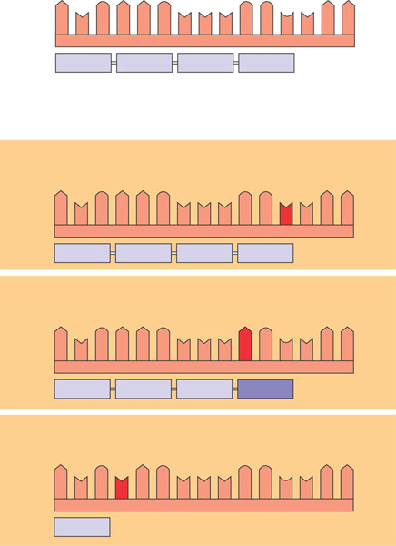
Base-pair substitution
Wild type
mRNA
A
U
G
A
A
G
U
U
U
G
G
C
U
A
A
5′
3′
Protein
Met
Lys
Phe
Gly
Stop
Amino end
Carboxyl end
Base-pair substitution
No effect on amino acid sequence
U instead of C
A
U
G
A
A
G
U
U
U
G
G
U
U
A
A
Met
Lys
Phe
Gly
Stop
Missense
A instead of G
Transition
Purine to Purine
And
Pyrimidine to pyrimidine
Transversion
Purine to pyrimidine
OR
Pyrimidine to Purine
A
U
G
A
A
G
U
U
U
A
G
U
U
A
A
Met
Lys
Phe
Ser
Stop
Nonsense
U instead of A
A
U
G
U
A
G
U
U
U
G
G
C
U
A
A
Met
Stop

Slide 27
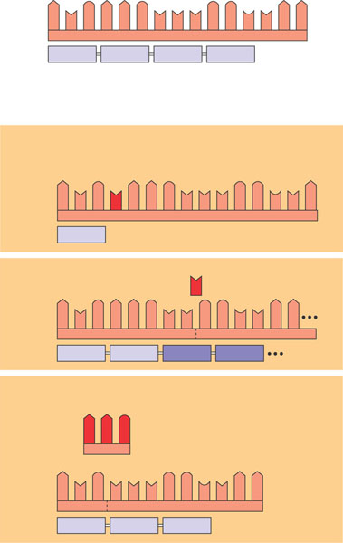
Base-pair insertion or deletion
Wild type
mRNA
5′
A
U
G
A
A
G
U
U
U
G
G
C
U
A
A
3′
Protein
Met
Lys
Phe
Gly
Stop
Amino end
Carboxyl end
Base-pair insertion or deletion
Frameshift causing immediate nonsense
Extra U
A
U
G
U
A
A
G
U
U
U
G
G
C
U
A
Met
Stop
Frameshift causing
extensive missense
U
Missing
A
U
G
A
A
G
U
U
G
G
C
U
A
A
Met
Lys
Leu
Ala
Insertion or deletion of 3 nucleotides:
no frameshift but extra or missing amino acid
A
A
G
Missing
A
U
G
U
U
U
G
G
C
U
A
A
Met
Phe
Gly
Stop

Slide 28
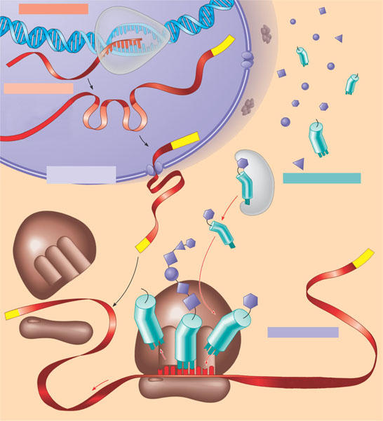
A summary of transcription and translation in a eukaryotic cell
TRANSCRIPTION
DNA
1
RNA is transcribed
from a DNA template.
3′
Poly-A
5′
RNA
transcript
RNA
polymerase
RNA PROCESSING
Exon
In eukaryotes, the
RNA transcript (pre-
mRNA) is spliced and
modified to produce
mRNA, which moves
from the nucleus to the
cytoplasm.
2
RNA transcript
(pre-mRNA)
Intron
Aminoacyl-tRNA
synthetase
NUCLEUS
Cap
FORMATION OF
INITIATION COMPLEX
Amino
acid
CYTOPLASM
After leaving the
nucleus, mRNA attaches
to the ribosome.
tRNA
AMINO ACID ACTIVATION
3
Each amino acid
attaches to its proper tRNA
with the help of a specific
enzyme and ATP.
4
mRNA
Growing
polypeptide
Poly-A
Activated
amino acid
Ribosomal
subunits
Poly-A
Cap
5′
TRANSLATION
C
A succession of tRNAs
add their amino acids to
the polypeptide chain
as the mRNA is moved
through the ribosome
one codon at a time.
(When completed, the
polypeptide is released
from the ribosome.)
C
5
A
U
E
A
A
C
Anticodon
A
A
U
A
G
G
U
G
U
U
U
A
Codon
Ribosome

